Slide 1
ENSE 470 - Milestone 6
Timbits
Maksym Zabutnyy, Earl Macalino, Jennifer Herasymuik
March 29th, 2018

Slide 2
Technology/Design Patterns
Lamp stack
HTML, CSS, JavaSript, PHP
Bootstrap
Design patterns
MVC (Model View Controller)
Model - our objects and data
View - responsible for visualization
Controller - updates the view in response to data flow
Major benefit is the decoupling the front-end and the back-end which allowed us to work on our project simultaneously. Able to work on different parts without breaking code on merges.
Previous familiarity with this popular design pattern streamlines efficiency.
Notes:
Maks

Slide 3
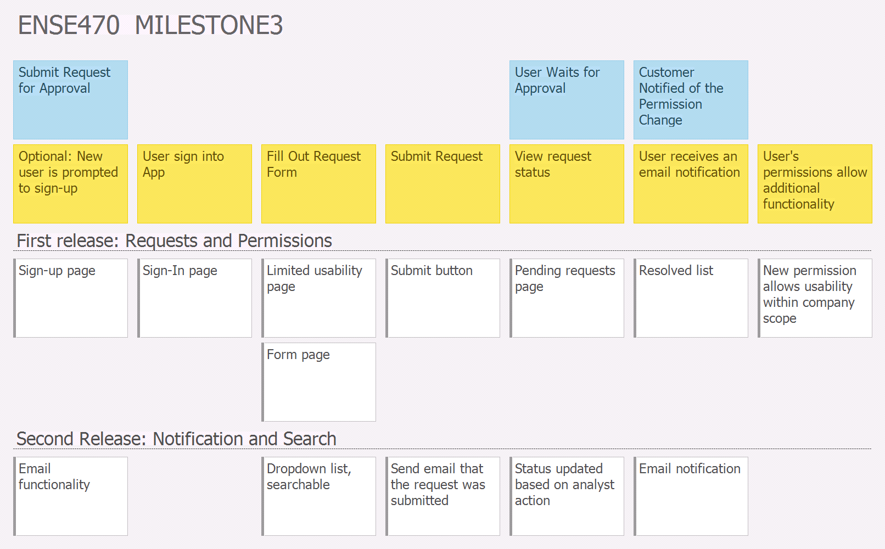
User Story Map
Notes:
Earl

Slide 4
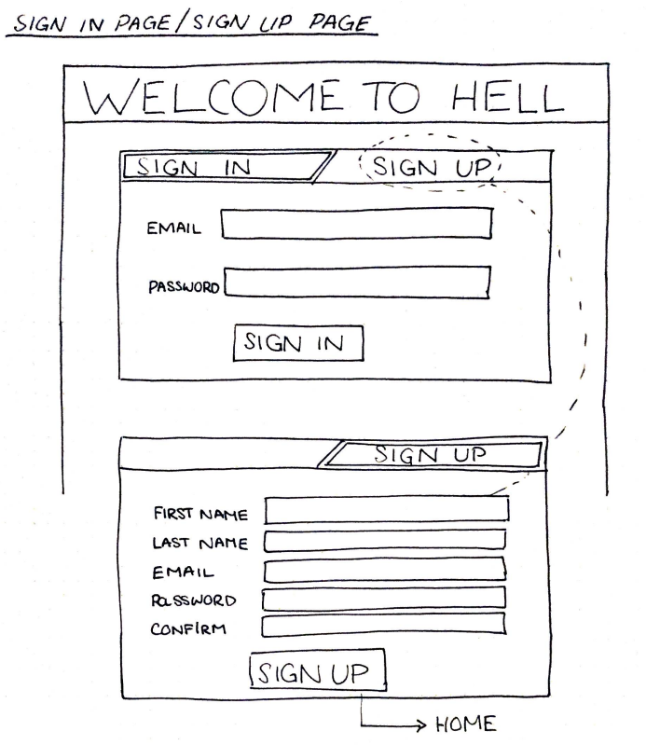
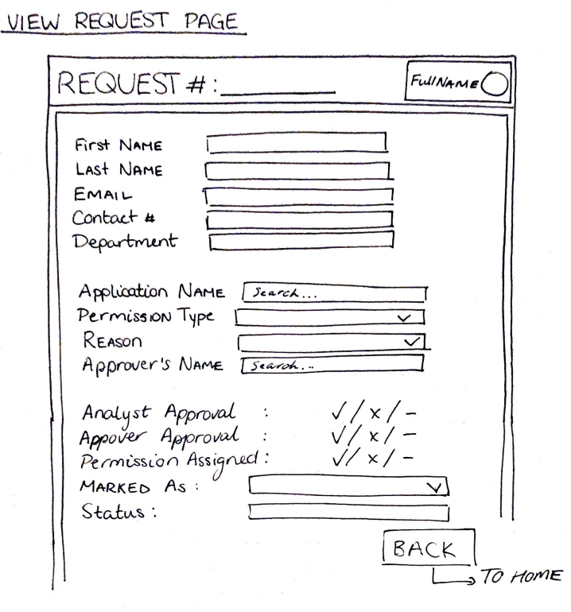
Lo-Fi Prototypes
Notes:
Maks

Slide 5
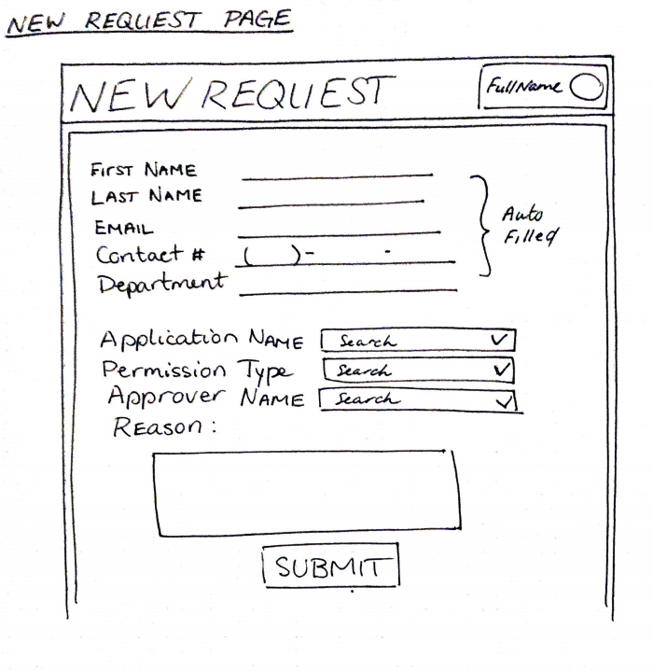
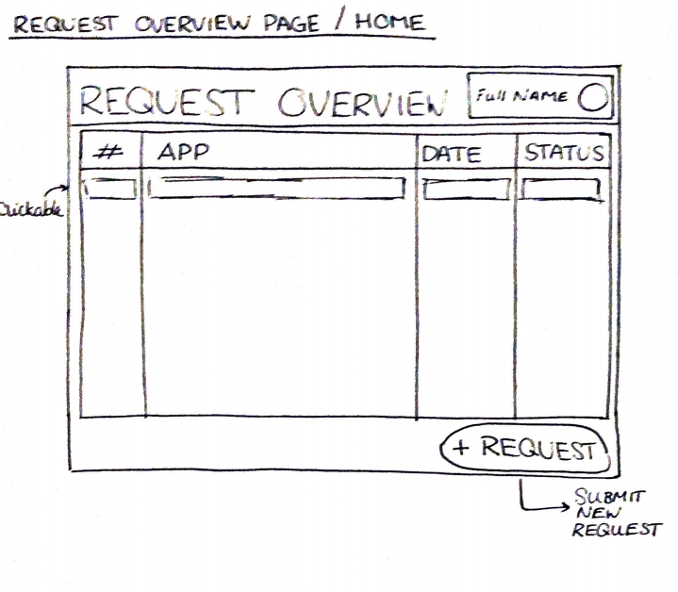
Lo-Fi Prototypes
Notes:
Maks

Slide 6
Demo
http://ense470timbits.com/index.php
Notes:
Jenn

Slide 7
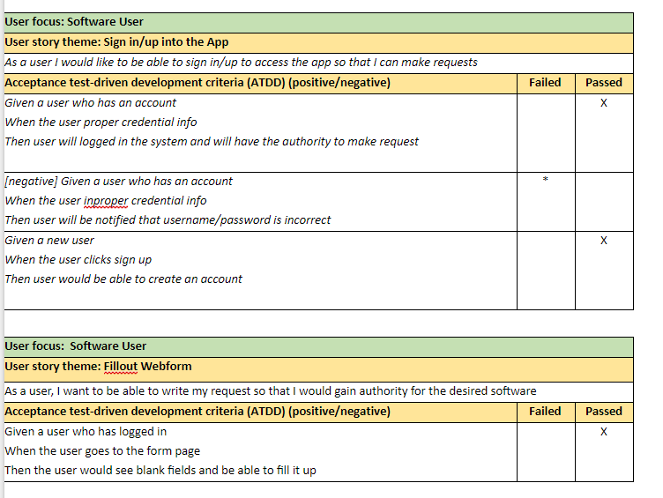
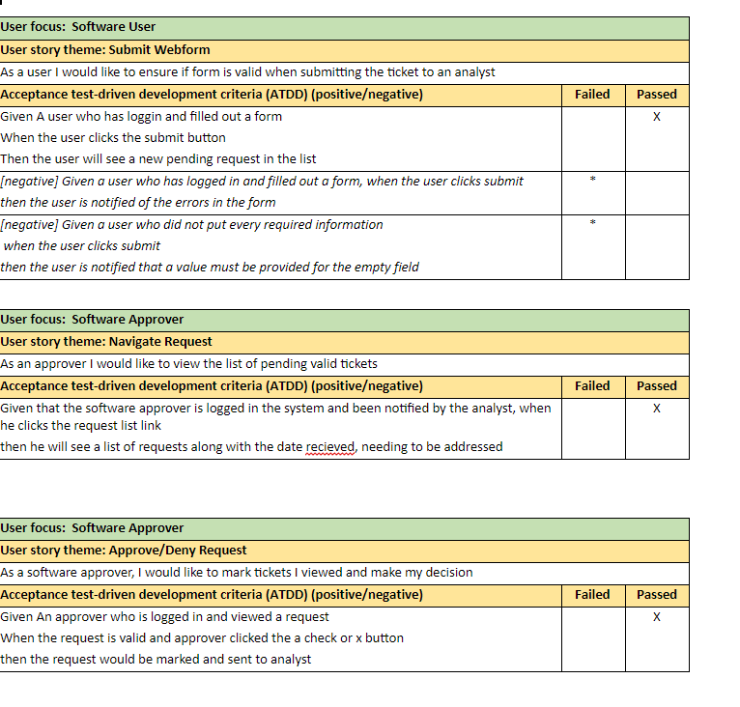
Test Cases
Notes:
Jenn

Slide 8
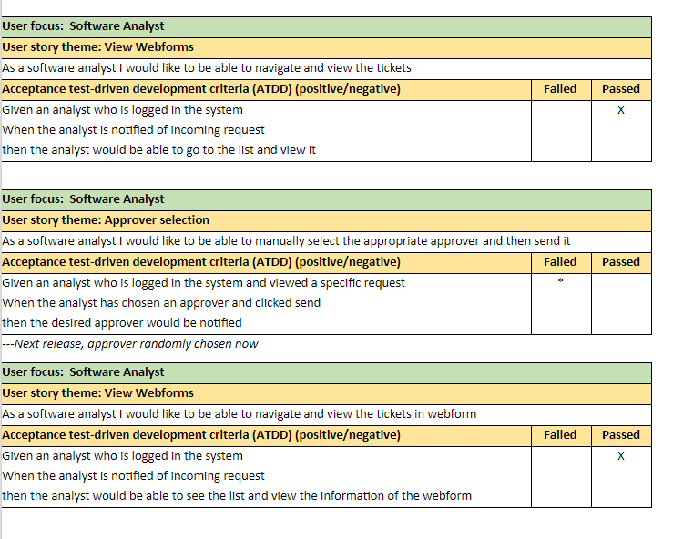
Test - Continued

Slide 9
Reflection
How did you feel about this milestone? What did you like about it? What did you dislike? We came, we saw, we coded. What did you learn about yourself as you collaborated and worked through this milestone? We were really lucky to break up the work based on strengths. Using a compatible design pattern we were able to work on the project at all hours without breaking each other’s code. How will you use what you have learned going forward? Benefit of teamwork is the ‘contract’ in order to make sure responsibilities are handled.
Notes:
Maks

